Slide 1

Can we use machine learning to predict startup success ?
Kyrian Bourgi
Ironhack Final Presentation
Data Analytics

Slide 2
Table of Contents
01
02
03
04
Problem Definition
Data Overview
Model Results
Conclusion

Slide 3
Problem Definition
How do we measure Success?
Which numerical feature can we base our predictions on ?
Compare model accuracies ( Logistic Regression & Random Forest )
What financing option are more successful in predicting the success of a company ?

Slide 4
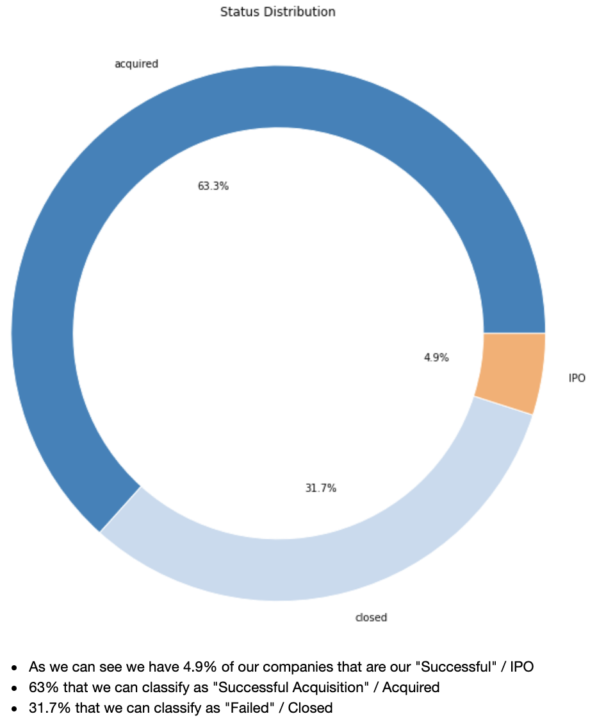
Analysis
Outreach
Status Distribution

Slide 5
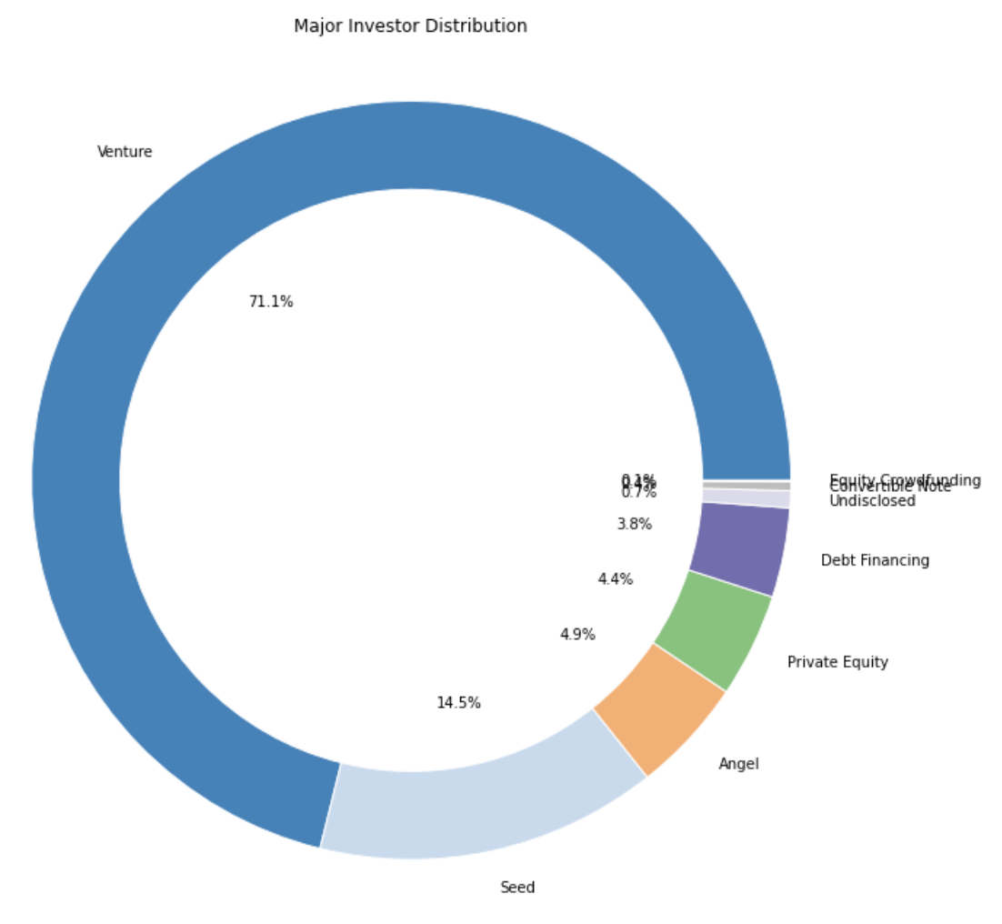
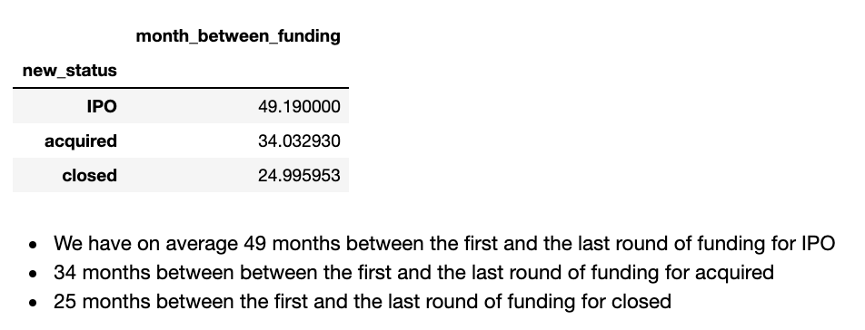

Slide 6
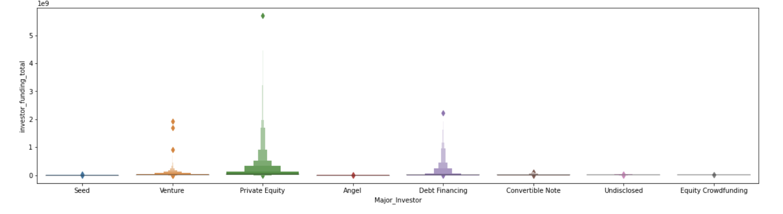
Distribution of the Major Financing Options
We can observe that most of the total funding comes from Private Equity, then Venture Capital and thirdly Debt Financing

Slide 7
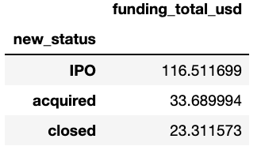
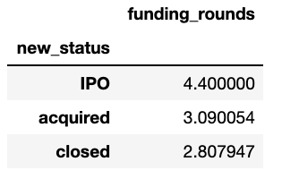
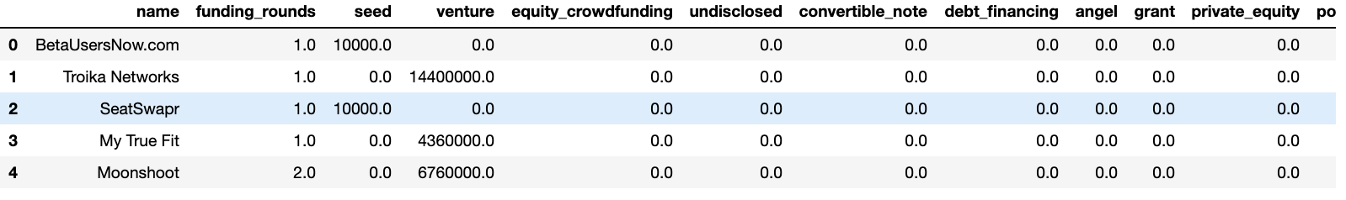
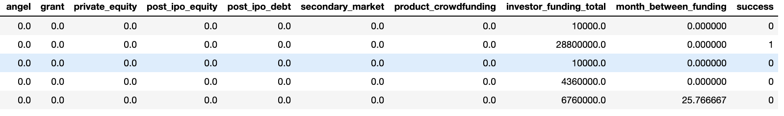
How would we predict success ?
1968 rows × 18 columns

Slide 8
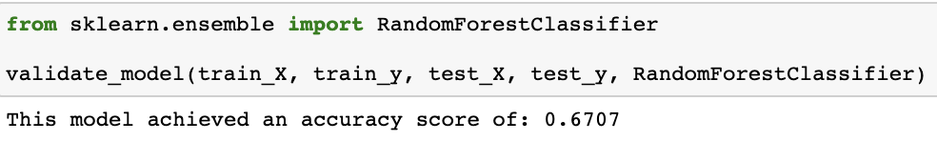
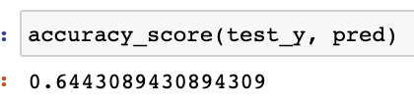
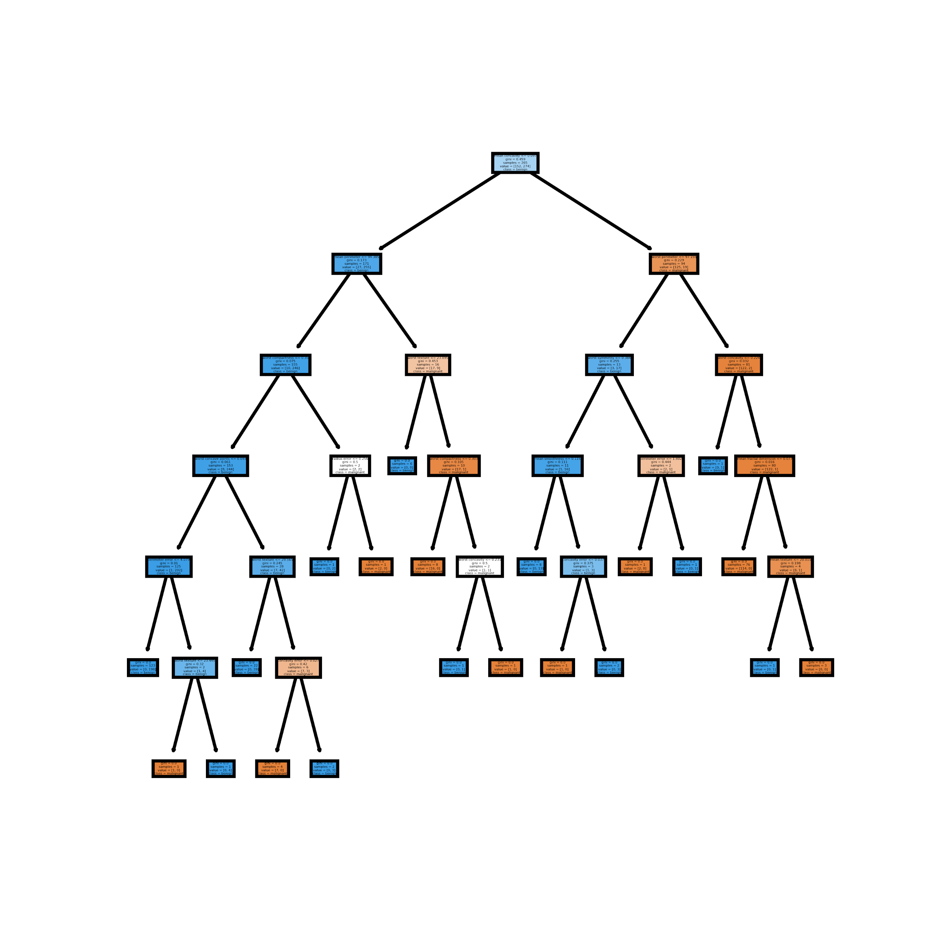

Machine Learning
Random Forest
Logistic Regression

Slide 9
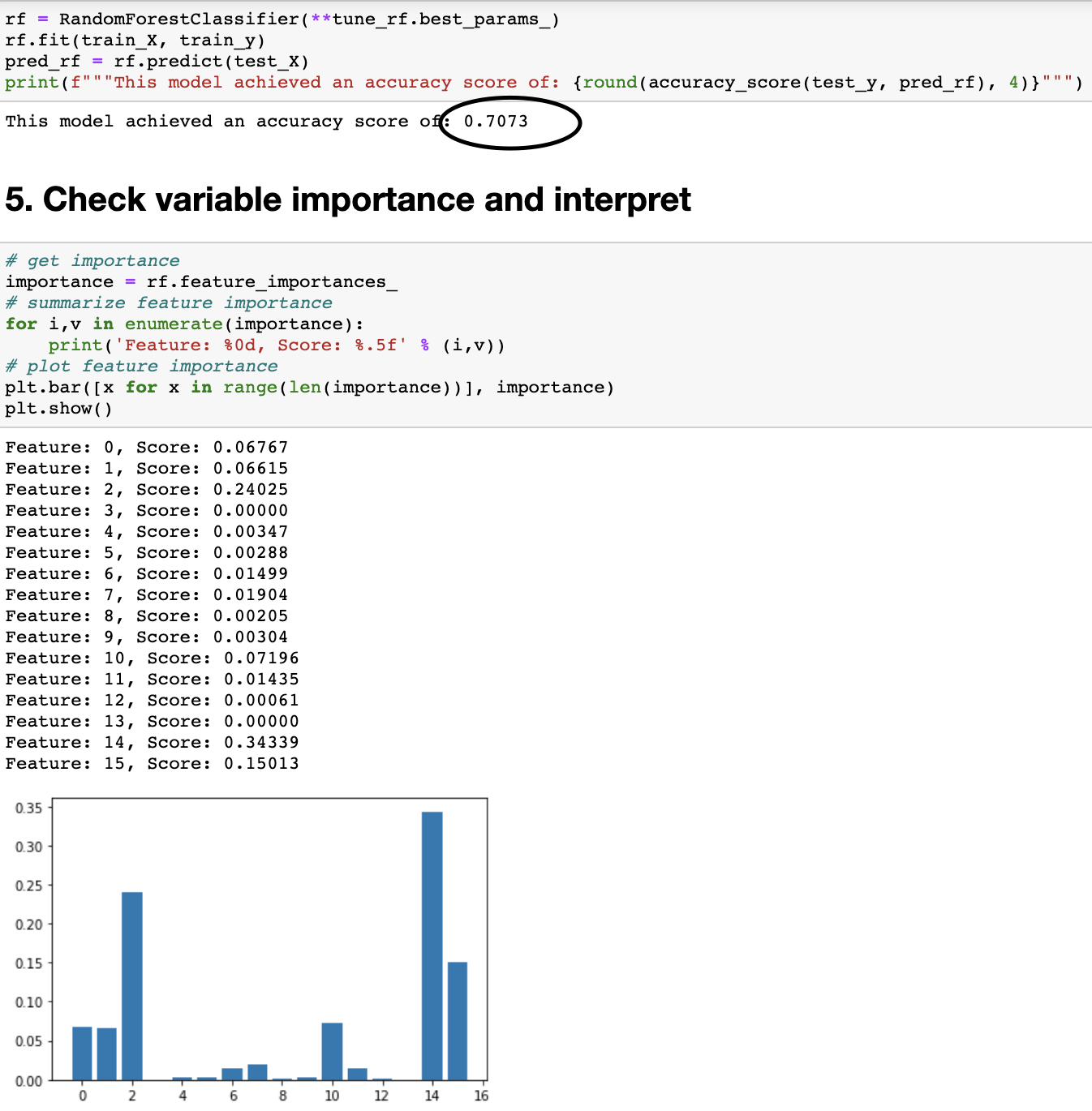
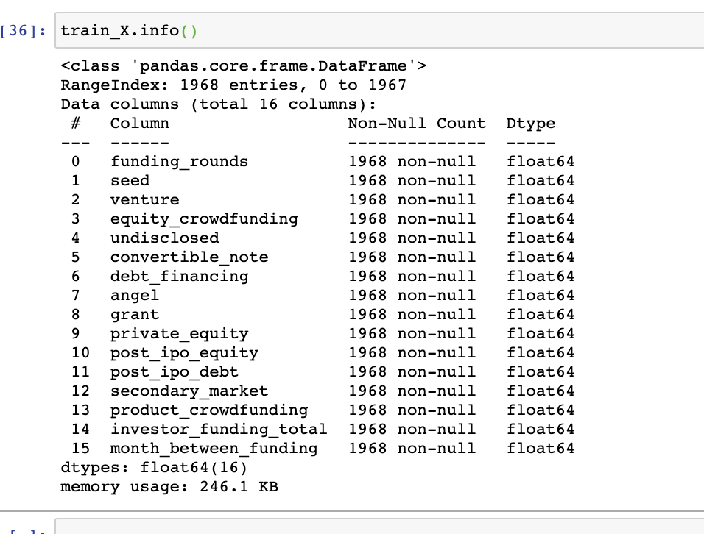
Results
$20K
10%
45K

Slide 10
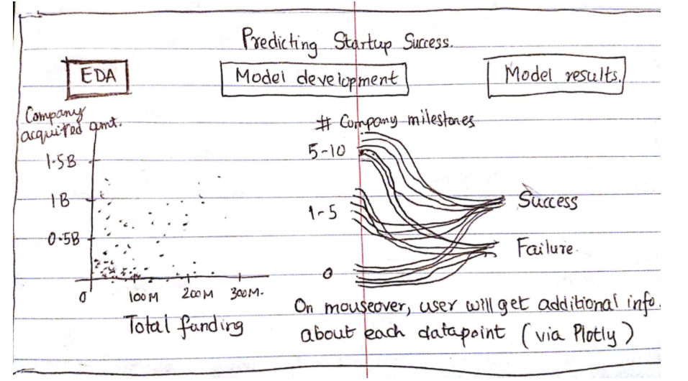
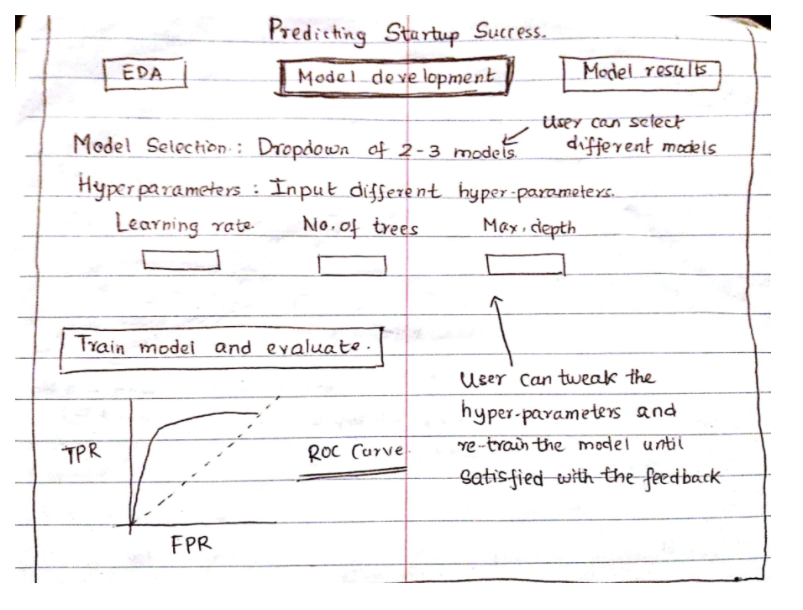
Model criticism & Open discussion

